Slide 1
ClimateWins Data Analysis
Kaci Erwin
April 2024

Slide 2
Objective
The data provided could be analyzed to test these hypotheses
Hypothesis: There has been a significant increase in average annual temperatures in mainland Europe over the past century.
Hypothesis: The frequency of extreme weather events, such as heatwaves and heavy precipitation, has increased over the last century
Hypothesis: Machine learning models can accurately predict favorable weather conditions and extreme weather events in mainland Europe based on historical weather data.
Leverage machine learning to predict future weather conditions and potential extreme weather events in mainland Europe using historical climate data.

Slide 3
Climate Data
Source
The data used by ClimateWins is the European Climate Assessment and Dataset (ECA&D), collected and funded by the Royal Netherlands Meteorological Institute (KNMI).
Contents
The ECA&D dataset includes a wide range of weather information, such as temperature, precipitation, wind speed, and humidity, from 18 weather stations across Europe. It spans multiple decades, enabling detailed analysis of historical weather patterns and trends.
Accuracy
The data from the ECA&D is meticulously collected and validated by the KNMI to ensure high accuracy and reliability. The weather stations are strategically located across Europe, providing a representative sample of the continent's diverse climate conditions.
Bias
Potential biases may arise from the geographic distribution of weather stations, which might not fully capture local variations in climate. Also, historical data collection methods and changes in measurement technology over time can introduce inconsistencies.

Slide 4
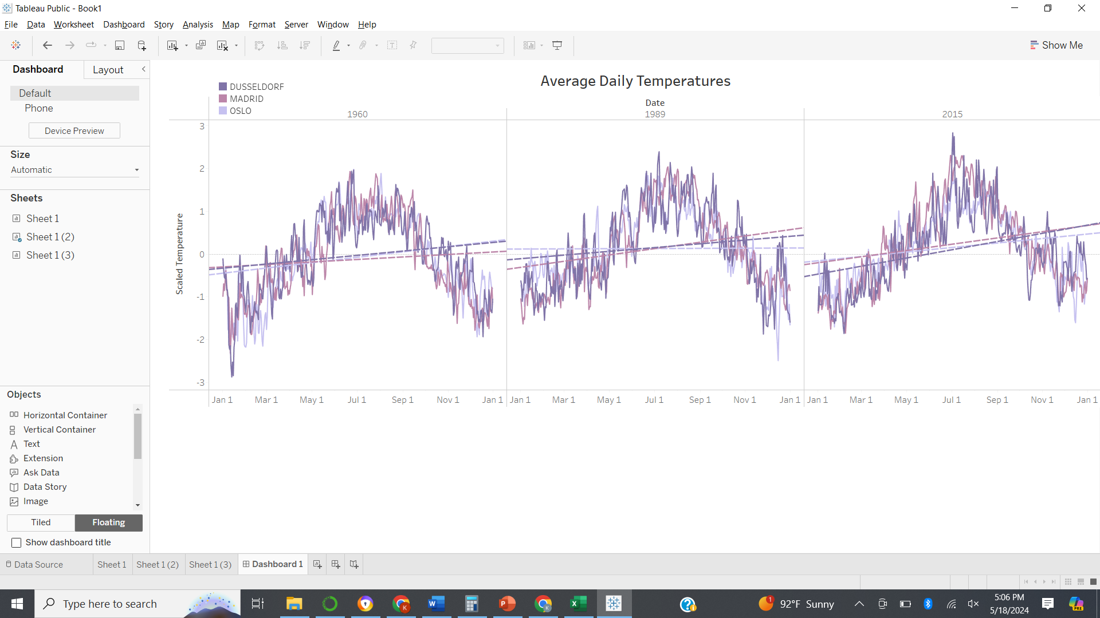
Gradient Descent Optimization
Gradient descent optimization was used to determine the features of the dataset by fitting a linear model to scaled daily average temperatures from 3 locations in 3 different years. The resulting slopes for each fit are shown.
Slopes (theta1) from gradient descent optimization
Location | 1960 | 1989 | 2015
Madrid | 0.095 | 0.24 | 0.24
Oslo | 0.2 | 0.0065 | 0.17
Dusseldorf | 0.16 | 0.14 | 0.31

Slide 5
Gradient Descent Optimization
Results
All three weather stations have positive slopes for all 3 years analyzed. These slopes indicate an upward trend in average temperatures each year suggesting that warming has occurred over the past several decades.
The magnitude of the slopes do not follow a chronological trend. The largest magnitude is found in different years for each location. This suggests that while warming is occurring it is not consistent.
The magnitude of the slopes do not follow a geographical trend. The largest magnitude is found at a different location for each year analyzed, indicating that the rate of temperature increase varies spatially across Europe. This suggests that different regions may be experiencing the impacts of climate change at different rates and intensities.
The analysis so far is limited. The analysis should be repeated for more years and more stations to provide more confidence in the results. The analysis should also be expanded to incorporate more climate data variables to provide more holistic results.

Slide 6
Supervised Machine Learning
A dataset that showed pleasantness ratings (as either 0 or 1) for each day at each station was added to the climate dataset. Three algorithms were used to model the data to predict pleasantness based on the climate variables.
K-Nearest Neighbors: This algorithm classifies a data point based on the most common class among its nearest neighbors in the feature space, using a distance metric to determine closeness.
Decision Tree: This model predicts outcomes by splitting the dataset into subsets based on feature values, creating a tree where each node represents a decision point, leading to a prediction at the leaf nodes.
Artificial Neural Network (MPClassifier): This algorithm uses interconnected layers of neurons that adjust their weights through training to learn complex patterns and make predictions.

Slide 7
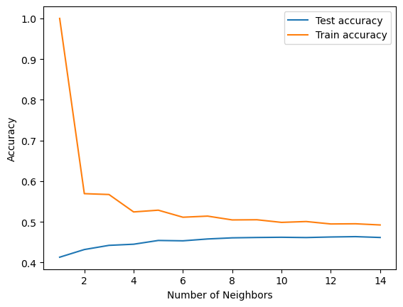
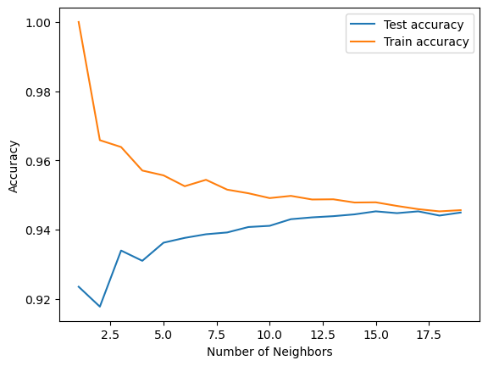
K- Nearest Neighbors: Analysis
A KNN model fit to the full climate dataset converges around 6 neighbors with a training accuracy of 0.49 and a testing accuracy of 0.46.
A KNN model fit to climate data for only the Heathrow station converged around 13 neighbors with a training accuracy of 0.95 and a testing accuracy of 0.94.
Accuracy vs Neighbors for Full Dataset
Accuracy vs Neighbors for Heathrow Dataset

Slide 8
K- Nearest Neighbors: Conclusion
Results
While the KNN model converges when fitted to the full dataset, the low accuracies indicate that the data's complexity leads to underfitting. In contrast, the high accuracies achieved by the KNN model on the simpler Heathrow dataset suggest that the model is well-suited and appropriate for this simpler data.
Conclusions
The KNN model shows promise for predicting weather pleasantness, particularly with simpler datasets. However, the low accuracies when applied to the full dataset indicate that the model may struggle with the complexity and variability of larger, more diverse data. This suggests that KNN, while appropriate in certain contexts, may benefit from additional preprocessing to improve its performance on complex datasets. Future steps could include feature engineering and possibly integrating more advanced modeling techniques to handle the complexity of the full dataset.

Slide 9
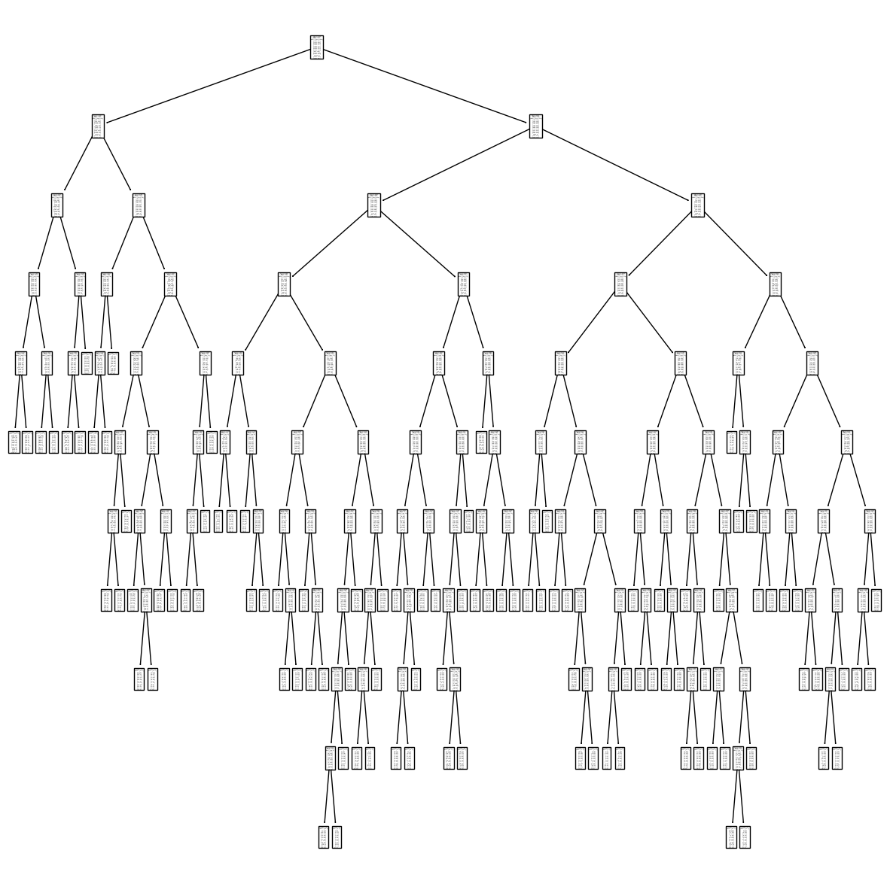
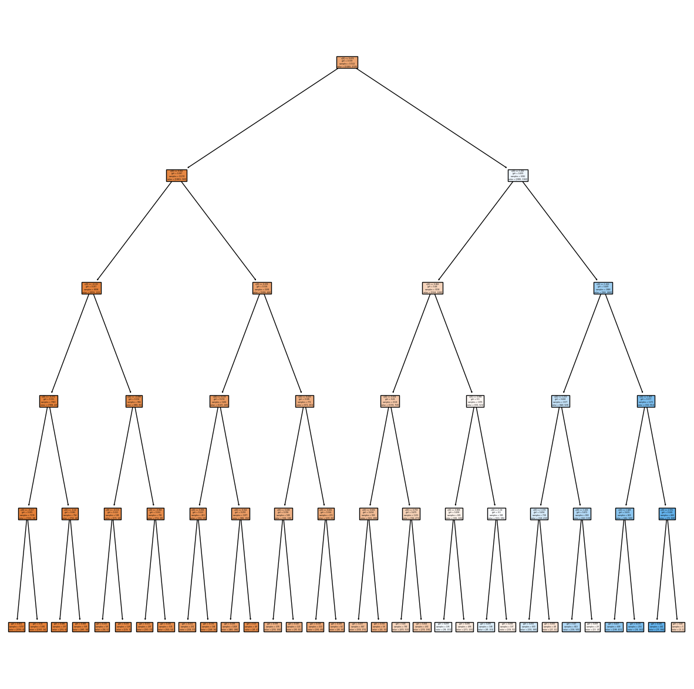
Decision Tree: Analysis
After parameter optimization, the decision tree created to fit the full dataset was complex with many nodes and long branches. The accuracy of this model fit to the training data is 0.83. The accuracy of this model fit to the testing data is 0.44.
Decision Tree for Full Dataset
Decision Tree for Heathrow Dataset
A decision tree was created to fit a dataset that contained only data for the Heathrow location. The accuracy of this model fit to the training data is 0.83. The accuracy of this model fit to the testing data is 0.84. The model shows bias in predictions with the “pleasant” outcome being mislabeled about half of the time.

Slide 10
Decision Tree: Conclusions
Results
The parameter-optimized decision tree model for the full dataset was complex and overfit the training data. The decision tree model achieved higher accuracy for a simpler dataset, but the model showed bias in the pleasantness predictions.
Conclusions
These results suggest that a decision tree can effectively model simpler, more homogeneous datasets but may struggle with more complex, heterogeneous data. If a decision tree model is chosen, the data may need to be segmented into simpler subsets for higher accuracy or ensemble methods (Random Forests) or feature engineering techniques could be implemented to improve the model performance for the full dataset.

Slide 11
Artificial Neural Network (MPCLassifier): Analysis
Parameters for an ANN model were adjusted while the model was fit to the full dataset. As adjustments were made, the training accuracies increased while the testing accuracies remained constant.
 | Run 1 | Run 2 | Run 3 | Run 4 | Run 5
Layers | 2 | 3 | 3 | 3 | 3
Nodes | 5, 5 | 20, 10, 10 | 100, 50, 20 | 200, 100, 100 | 200, 200, 200
iter | 500 | 1000 | 1000 | 1000 | 1000
tolerance | 0.0001 | 0.0001 | 0.0001 | 0.000001 | 0.000001
converged? | yes | yes | yes | yes | yes
Test Accuracy | 0.44 | 0.45 | 0.44 | 0.44 | 0.42
Train Accuracy | 0.44 | 0.46 | 0.48 | 0.58 | 0.78

Slide 12
Artificial Neural Network (MPCLassifier): Conclusions
Results
While the ANN models converge when fit to the full dataset, the resulting accuracies indicate that as the models become more complex, they begin to overfit the data. This overfitting suggests that the models are capturing noise and specific patterns in the training data rather than generalizable trends.
Conclusion
An ANN model that fits the data appropriately has not yet been identified. Despite this, ANN models have many parameters that can be adjusted to help the models fit complex data more effectively. These include network architecture, activation functions, regularization techniques, training epochs, and early stopping. Further model refinement could identify the optimal configuration for this dataset.

Slide 13
Conclusions: which model should we use?
Model Results
KNN: KNN performs well with simpler datasets but struggles with the complexity of the full dataset, leading to underfitting.
Decision Tree: This model overfits the full dataset but performs well on simpler datasets, though it shows bias in predictions.
ANN: ANN models overfit the data as the model’s complexity increases, capturing noise rather than general trends.
Recommendations
Tuning and hybrid approach: Experiment with parameter tuning, ensemble methods, and hybrid models to balance the complexity of the data with the complexity of the models.
Data Segmentations: If the models prove difficult to appropriately tune, consider segmenting data by region to reduce variables and improve model accuracy.
Regularization: Apply regularization methods in complex models to mitigate overfitting and improve generalization.
While all models show potential with appropriate data segmentation and/or further model tuning, the more complex models (Decision Tree and ANN) have the highest potential to fit the dataset. A hybrid model approach is recommended.

Slide 14
Thank you!

